Slide 1


Football Field
Reservation System
SUPERVISOR:
TEAM MEMBERS
Mr. Kiều Trọng Khánh
Mai Minh Quý – Leader
Trương Hữu Thành
Phan Minh Huấn
Phạm Trung Hiếu

Slide 2

AGENDA
01
Introduction
02
Implementation
03
Values and Challenge
04
Future Plan
2

Slide 3
Part 1
Introduction

Slide 4
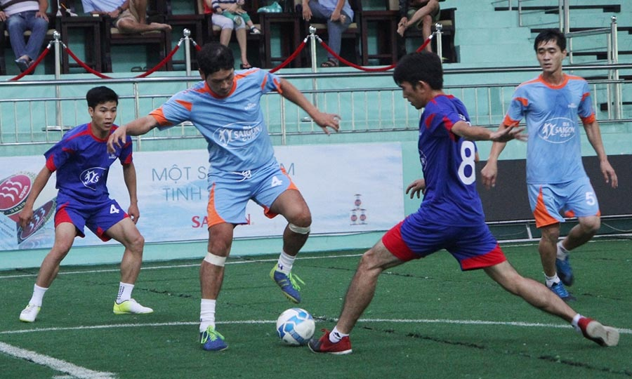
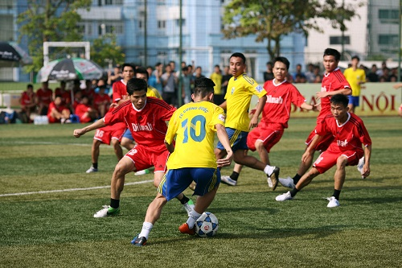
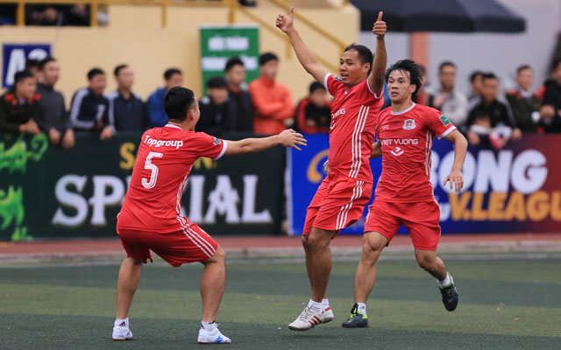
F
is an increasing trend
ootball
for all ages.
4

Slide 5

Scenario 1
Mr. Thành
5

Slide 6

Scenario 1
1. Calls or goes to field to reserve
Mr. Thành
Field Owner
6

Slide 7

Scenario 1
1. Calls or goes to field to reserve
2. Checks free time
Mr. Thành
Field Owner
7

Slide 8
Scenario 1
1. Calls or goes to field to reserve
2. Checks free time
3. Replies about reservation request
Mr. Thành
Field Owner
8

Slide 9
Scenario 1
1. Calls or goes to field to reserve
2. Checks free time
3. Replies about reservation request
4. Records reservation request on paper
Mr. Thành
Field Owner
9

Slide 10

Scenario 1
1. Calls or goes to field to reserve
2. Checks free time
4. Replies about reservation request
3. Records reservation request on paper
Mr. Thành
Field Owner
5. Notifies to members in team
Team Member
10

Slide 11
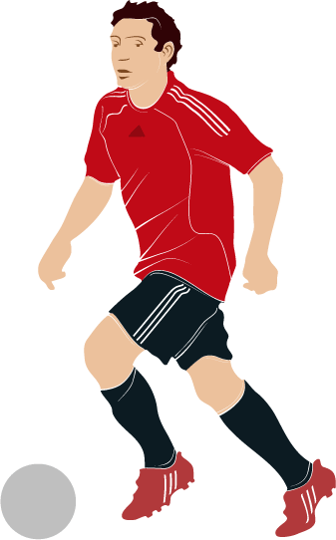
Scenario 1
1. Calls or goes to field to reserve
2. Checks free time
4. Replies about reservation request
3. Records reservation request on paper
Mr. Thành
Field Owner
5. Notifies to members in team
6. Go to field and kick-off
Team Member
11

Slide 12


Scenario 1
1. Calls or goes to field to reserve
2. Checks free time
4. Replies about reservation request
3. Records reservation request on paper
Mr. Thành
Field Owner
7. Pays cash
5. Notifies to members in team
Current Process
6. Go to field and kick-off
Team Member
12

Slide 13
Problems of Scenario 1
Calls or goes to field but free time of field is over
Try with another familiar fields but not found.
Wastes time but no results
Like football but can not play
Mr. Thành
13

Slide 14
Problems of Scenario 1
Calls or goes to field but free time of field is over
Try with another familiar fields but not found.
Wastes time but no results
Like football but can not play
Mr. Thành
Down mood, boring
14

Slide 15

Problems
Problems of Scenario 1
Calls or goes to field but free time of field is over
Try with another familiar fields but not found.
Wastes time but no results
Like football but can not play
Mr. Thành
- The field near home has free time but Mr. Thành doesn’t know and doesn’t like unfamiliar fields.
- During rush hours, finding a field becomes more difficult.
Down mood, boring
15

Slide 16

Problems of Scenario 1
Manages time schedule on paper should be easy to shortcomings
Field Owner
16

Slide 17

Problems of Scenario 1
Manages time schedule on paper should be easy to shortcomings
Spends a lot of time for answering the phone from customer
Field Owner
17

Slide 18

Problems of Scenario 1
Manages time schedule on paper should be easy to shortcomings
Spends a lot of time for answering the phone from customer
Field Owner
Finds customers passively because she does not have way to advertise football field
18

Slide 19
Problems of Scenario 1
Manages time schedule on paper should be easy to shortcomings
Spends a lot of time for answering the phone from customer
Field Owner
Finds customers passively because she does not have way to advertise football field
Does not have customers at idle hours
19

Slide 20
Problems of Scenario 1
Manages time schedule on paper should be easy to shortcomings
Spends a lot of time for answering the phone from customer
Field Owner
Finds customers passively because she does not have way to advertise football field
Does not have customers at idle hours
Incomes are not improved
20

Slide 21

Scenario 2
1. Mr. Thành does not have enough members to play football and want to find another team.
2. Mr. Thành’s football team want to play with another team to change mood.
Mr. Thành
21

Slide 22
Scenario 2
Mr. Thành
22

Slide 23
Scenario 2
1. Calls or goes field to propose matching opponent
Mr. Thành
Field Owner
23

Slide 24
Scenario 2
1. Calls or goes field to propose matching opponent
2. Checks free time
Mr. Thành
Field Owner
24

Slide 25

Scenario 2
1. Calls or goes field to propose matching opponent
2. Checks free time
3. Finds opponent
Mr. Thành
Field Owner
25

Slide 26
Scenario 2
1. Calls or goes field to propose matching opponent
2. Checks free time
4. Notifies about opponent
3. Finds opponent
Mr. Thành
Field Owner
26

Slide 27
Scenario 2
1. Calls or goes field to propose matching opponent
2. Checks free time
4. Notifies about opponent
3. Finds opponent
5. Confirms to play with suggested opponent
Mr. Thành
Field Owner
27

Slide 28
Scenario 2
Scenario 2
6. Notifies to opposing team
1. Calls or goes field to propose matching opponent
2. Checks free time
4. Notifies about opponent
3. Finds opponent
5. Confirms to play with suggested opponent
Mr. Thành
Field Owner
28

Slide 29
Scenario 2
Scenario 2
6. Notifies to opposing team
1. Calls or goes field to propose matching opponent
2. Checks free time
4. Notifies about opponent
3. Finds opponent
7. Records reservation request on paper
5. Confirms to play with suggested opponent
Mr. Thành
Field Owner
29

Slide 30
Scenario 2
6. Notifies to opposing team
1. Calls or goes field to propose matching opponent
2. Checks free time
4. Notifies about opponent
3. Finds opponent
7. Records reservation request on paper
5. Confirms to play with suggested opponent
Mr. Thành
Field Owner
8. Notifies to members in team
Team Member
30

Slide 31

Scenario 2
6. Notifies to opposing team
1. Calls or goes field to propose matching opponent
2. Checks free time
4. Notifies about opponent
3. Finds opponent
7. Records reservation request on paper
5. Confirms to play with suggested opponent
Mr. Thành
Field Owner
8. Notifies to members in team
9. Go to field and kick-off
Team Member
31

Slide 32


Scenario 2
6. Notifies to opposing team
1. Calls or goes field to propose matching opponent
2. Checks free time
4. Notifies about opponent
3. Finds opponent
7. Records reservation request on paper
5. Confirms to play with suggested opponent
Mr. Thành
Field Owner
10. Pays cash
8. Notifies to members in team
Current Process
9. Go to field and kick-off
Team Member
32

Slide 33
Problems of Scenario 2
Matching opponent is depended on the perspective of field owner.
Number of opponents is very small, only teams play same field.
33

Slide 34
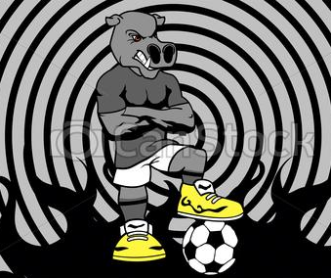
Problems of Scenario 2
Problems
Matching opponent is depended on the perspective of field owner.
Number of opponents is very small, only teams play same field.
- Opponent has bad attitude.
- Have too big difference about level
34

Slide 35
Problems of Scenario 2
Matching opponent is depended on the perspective of field owner.
Number of opponents is very small, only teams play same field.
- Opponent has bad attitude.
- Have too big difference about level
The match does not meet player’s expectation
35

Slide 36

Our idea
requests
Mr. Thành
Field Owner
36

Slide 37
Our idea
requests
responses
Mr. Thành
Field Owner
37

Slide 38
Our idea
requests
notifies
responses
Mr. Thành
Field Owner
38

Slide 39
Our idea
requests
notifies
responses
Mr. Thành
approves
Field Owner
39

Slide 40
Our idea
requests
notifies
responses
Mr. Thành
approves
Field Owner
notifies
notifies
FFRS is the bridge between the field owner and player.
40

Slide 41

Our idea
Solution
Reserves field and pays online
Receives suggestion about field around house, company…
Mr. Thành
Receives suggestion about opponent based on rating score
41

Slide 42
Our idea
Solution
Manages reservation request easily, quickly and effectively
Has more customers at idle hours
Field Owner
42

Slide 43
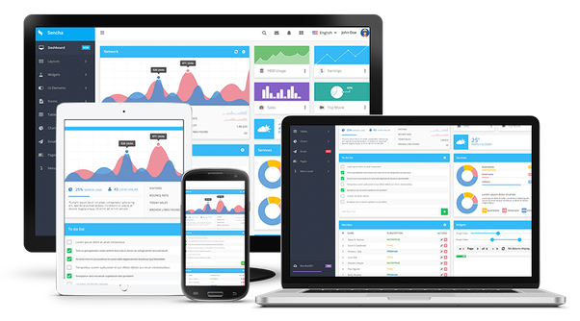

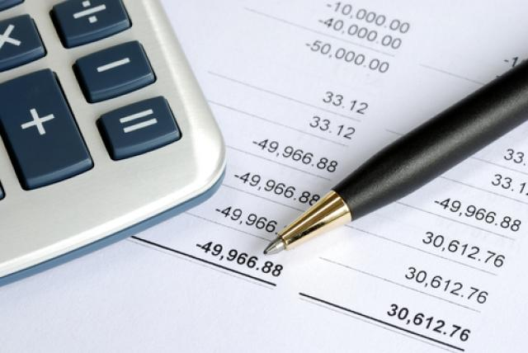

For field owner
Web Application
Provide promotion for advertising
Manage field, time quickly and effectively
Manage profit easily
43

Slide 44
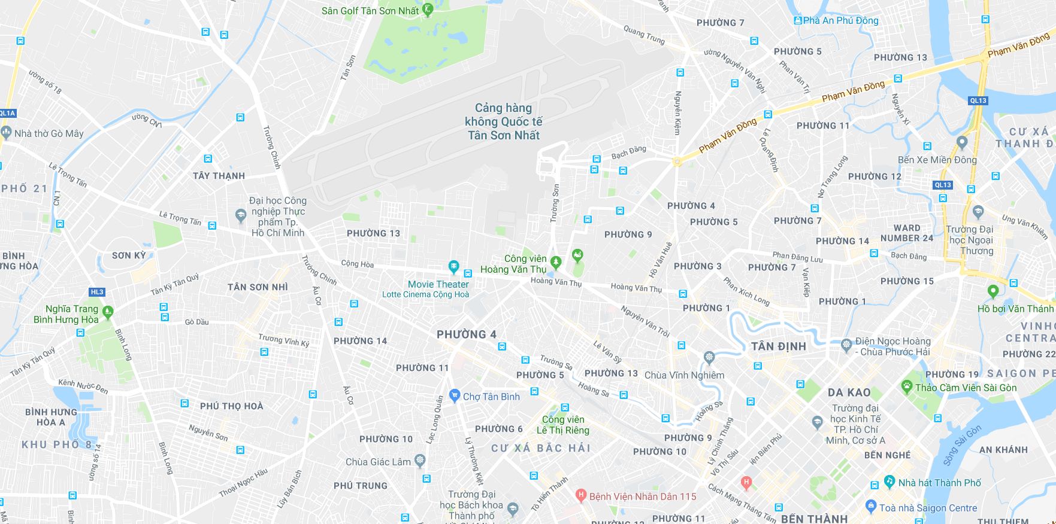



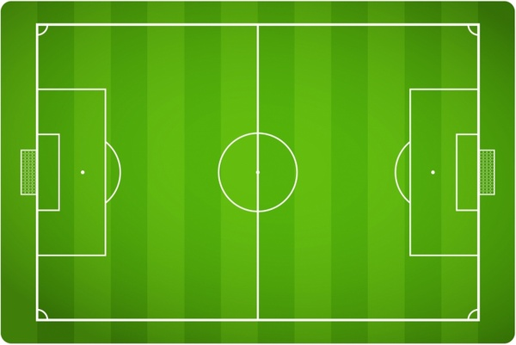


For players
Mobile Application
Reserve field and pay online
Search field by position,
by name
Find the suitable opponent
44

Slide 45
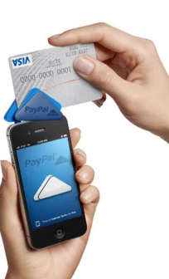
Supports
Online Payment
Notify to member
45

Slide 46


User
User has passionate about football and use reservation services
Field Owner has football fields and provide reservation services
Staff is a member of FFR, he/she manages the general and solves problems for user and field owner
Admin is a member of FFR, he/she manages staff account and lock/unlock account
46

Slide 47
Part 2
Implementation

Slide 48




Architecture
Web Server
Web Service API
1. request
2. Send HTTP Request
Web Browser
MVC Model
API
10. return
9. Send HTTP Response
3. Call
8. Return
Business Logic
7. Return
4. Call
DAO
6. Return
5. Call
Database
48

Slide 49
Mobile Application
Architecture
Web Service API
1. Send HTTP Request
Activity
API
8. Send HTTP Response
2. Call
9. Fill data
7. Return
Business Logic
Model
6. Return
3. Call
DAO
5. Return
4. Call
Database
49

Slide 50
Our approach
Field 1
Cây Trâm Field Owner has 3 working field :
Field 1, Field 2, Field 3
Field 2
Cây Trâm
Field Owner
Field 3
50

Slide 51




Our approach
1. Mr. Huấn 07h – 09h
2. Mr. Hiếu
10h – 13h
Cây Trâm Field Owner has 6 reservation requests.
3. Mr. Trung 07h – 10h
6. Mr. Quý
09h – 13h
Cây Trâm
Field Owner
4. Mr. Thành 08h – 11h
5. Mr. Hiệp 11h – 13h
51

Slide 52
Cây Trâm Field Owner
Our approach
How to arrange reservation request?
Request 1: 07h - 09h
Request 2: 10h - 13h
Request 3: 07h - 10h
Request 4: 08h - 11h
Request 5: 11h - 13h
Request 6: 09h - 13h
Field 1
Field 2
Field 3
07h – 08h
08h – 09h
09h – 10h
10h – 11h
11h – 12h
12h – 13h
52

Slide 53
Our approach
Arrange Time
Algorithms
Cây Trâm Field Owner
Request 1: 07h – 09h
Field 1
Field 2
Field 3
07h – 08h
08h – 09h
09h – 10h
10h – 11h
11h – 12h
12h – 13h
53

Slide 54
Our approach
Arrange Time
Algorithms
Cây Trâm Field Owner
Request 1: 07h – 09h
Request 2: 10h - 13h
Field 1
Field 2
Field 3
07h – 08h
08h – 09h
09h – 10h
10h – 11h
11h – 12h
12h – 13h
54

Slide 55
Our approach
Arrange Time
Algorithms
Cây Trâm Field Owner
Request 1: 07h – 09h
Request 2: 10h - 13h
Request 3: 07h – 10h
Field 1
Field 2
Field 3
07h – 08h
08h – 09h
09h – 10h
10h – 11h
11h – 12h
12h – 13h
55

Slide 56
Our approach
Arrange Time
Cây Trâm Field Owner
Request 1: 07h – 09h
Request 2: 10h - 13h
Request 3: 07h – 10h
Request 4: 08h – 11h
Field 1
Field 2
Field 3
07h – 08h
08h – 09h
09h – 10h
10h – 11h
11h – 12h
12h – 13h
56

Slide 57
Our approach
Arrange Time
Cây Trâm Field Owner
Request 1: 07h – 09h
Request 2: 10h - 13h
Request 3: 07h – 10h
Request 4: 08h – 11h
Request 5:11h – 13h
Field 1
Field 2
Field 3
07h – 08h
08h – 09h
09h – 10h
10h – 11h
11h – 12h
12h – 13h
57

Slide 58
Our approach
Arrange Time
Cây Trâm Field Owner
Request 1: 07h – 09h
Request 2: 10h - 13h
Request 3: 07h – 10h
Request 4: 08h – 11h
Request 5:11h – 13h
Request 6: 09h – 13h
Field 1
Field 2
Field 3
07h – 08h
08h – 09h
09h – 10h
10h – 11h
11h – 12h
12h – 13h
58

Slide 59
Our approach
Arrange Time
Cây Trâm Field Owner
Request 1: 07h – 09h
Request 2: 10h - 13h
Request 3: 07h – 10h
Request 4: 08h – 11h
Request 5:11h – 13h
Request 6: 09h – 13h
Field 1
Field 2
Field 3
07h – 08h
08h – 09h
09h – 10h
10h – 11h
11h – 12h
12h – 13h
2
1
59

Slide 60
Our approach
Arrange Time
Cây Trâm Field Owner
Request 1: 07h – 09h
Request 2: 10h - 13h
Request 3: 07h – 10h
Request 4: 08h – 11h
Request 5:11h – 13h
Request 6: 09h – 13h
Field 1
Field 2
Field 3
07h – 08h
08h – 09h
09h – 10h
10h – 11h
11h – 12h
12h – 13h
60

Slide 61
How the system can arranges time ?
Algorithms
Problems
Arrange Time
Algorithms
Algorithms
Our system used synchronization mechanism to handle requests sequentially
61
Notes:
Hệ thống của chúng tôi sử dụng cơ chế đồng bộ để xử lý các yêu cầu đặt sân một cách tuần tự

Slide 62
Algorithms
Algorithms
Algorithms
Problems
Arrange Time
Algorithms
Cây Trâm Field Owner
Request 1: 07h – 09h
Request 2: 10h - 13h
Request 3: 07h – 10h
Request 4: 08h – 11h
Request 5:11h – 13h
Request 6: 09h – 13h
Field 1
Field 2
Field 3
07h – 08h
08h – 09h
09h – 10h
10h – 11h
11h – 12h
12h – 13h
62

Slide 63
Algorithms
Solving
Arrange Time
Algorithms
Algorithms
Step 1: Divide Request 6 into time frames
per 1 hour
Request 1: 07h – 09h
Request 2: 10h - 13h
Request 3: 07h – 10h
Request 4: 08h – 11h
Request 5:11h – 13h
Request 6: 09h – 13h
Field 1
Field 2
Field 3
07h – 08h
08h – 09h
09h – 10h
09h – 10h
10h – 11h
10h – 11h
11h – 12h
11h – 12h
12h – 13h
12h – 13h
63

Slide 64
Algorithms
Solving
Arrange Time
Algorithms
Step 2: Choose a field which can contain the first time frame of request, then put the first time frame in this field In this case, the time frame 09h – 10h was put into Field 1
Request 1: 07h – 09h
Request 2: 10h - 13h
Request 3: 07h – 10h
Request 4: 08h – 11h
Request 5:11h – 13h
Request 6: 09h – 13h
Field 1
Field 2
Field 3
07h – 08h
08h – 09h
09h – 10h
09h – 10h
10h – 11h
10h – 11h
11h – 12h
11h – 12h
12h – 13h
12h – 13h
64

Slide 65
Algorithms
Solving
Arrange Time
Algorithms
Step 2: Choose a field which can contain the first time frame of request, then put the first time frame in this field In this case, the time frame 09h – 10h was put into Field 1
Request 1: 07h – 09h
Request 2: 10h - 13h
Request 3: 07h – 10h
Request 4: 08h – 11h
Request 5:11h – 13h
Request 6: 09h – 13h
Field 1
Field 2
Field 3
07h – 08h
08h – 09h
09h – 10h
10h – 11h
10h – 11h
11h – 12h
11h – 12h
12h – 13h
12h – 13h
65

Slide 66
Algorithms
Solving
Arrange Time
Step 3: For each remaining time frame, find the field can contain time frame, then swap all requests (from this time frame to end time) between Field 1 and target field
Request 1: 07h – 09h
Request 2: 10h - 13h
Request 3: 07h – 10h
Request 4: 08h – 11h
Request 5:11h – 13h
Request 6: 09h – 13h
Field 1
Field 2
Field 3
07h – 08h
08h – 09h
09h – 10h
10h – 11h
10h – 11h
11h – 12h
11h – 12h
12h – 13h
12h – 13h
66

Slide 67
Algorithms
Solving
Arrange Time
Step 3: For each remaining time frame, find the field can contain time frame, then swap all requests (from this time frame to end time) between Field 1 and target field
Request 1: 07h – 09h
Request 2: 10h - 13h
Request 3: 07h – 10h
Request 4: 08h – 11h
Request 5:11h – 13h
Request 6: 09h – 13h
Field 1
Field 2
Field 3
07h – 08h
08h – 09h
09h – 10h
10h – 11h
10h – 11h
11h – 12h
11h – 12h
12h – 13h
12h – 13h
67

Slide 68
Algorithms
Solving
Arrange Time
Step 3: For each remaining time frame, find the field can contain time frame, then swap all requests (from this time frame to end time) between Field 1 and target field
Request 1: 07h – 09h
Request 2: 10h - 13h
Request 3: 07h – 10h
Request 4: 08h – 11h
Request 5:11h – 13h
Request 6: 09h – 13h
Field 1
Field 2
Field 3
07h – 08h
08h – 09h
09h – 10h
10h – 11h
10h – 11h
11h – 12h
11h – 12h
12h – 13h
12h – 13h
68

Slide 69
Algorithms
Solving
Arrange Time
Algorithms
Step 3: For each remaining time frame, find the field can contain time frame, then swap all requests (from this time frame to end time) between Field 1 and target field
Request 1: 07h – 09h
Request 2: 10h - 13h
Request 3: 07h – 10h
Request 4: 08h – 11h
Request 5:11h – 13h
Request 6: 09h – 13h
Field 1
Field 2
Field 3
07h – 08h
08h – 09h
09h – 10h
10h – 11h
10h – 11h
11h – 12h
11h – 12h
12h – 13h
12h – 13h
69

Slide 70
Algorithms
Solving
Arrange Time
Step 3: For each remaining time frame, find the field can contain time frame, then swap all requests (from this time frame to end time) between Field 1 and target field
Request 1: 07h – 09h
Request 2: 10h - 13h
Request 3: 07h – 10h
Request 4: 08h – 11h
Request 5:11h – 13h
Request 6: 09h – 13h
Field 1
Field 2
Field 3
07h – 08h
08h – 09h
09h – 10h
10h – 11h
11h – 12h
11h – 12h
12h – 13h
12h – 13h
70

Slide 71
Algorithms
Solving
Arrange Time
Step 3: For each remaining time frame, find the field can contain time frame, then swap all requests (from this time frame to end time) between Field 1 and target field
Request 1: 07h – 09h
Request 2: 10h - 13h
Request 3: 07h – 10h
Request 4: 08h – 11h
Request 5:11h – 13h
Request 6: 09h – 13h
Field 1
Field 2
Field 3
07h – 08h
08h – 09h
09h – 10h
10h – 11h
11h – 12h
11h – 12h
12h – 13h
12h – 13h
71

Slide 72
Algorithms
Solving
Arrange Time
Algorithms
Step 3: For each remaining time frame, find the field can contain time frame, then swap all requests (from this time frame to end time) between Field 1 and target field
Request 1: 07h – 09h
Request 2: 10h - 13h
Request 3: 07h – 10h
Request 4: 08h – 11h
Request 5:11h – 13h
Request 6: 09h – 13h
Field 1
Field 2
Field 3
07h – 08h
08h – 09h
09h – 10h
10h – 11h
11h – 12h
11h – 12h
12h – 13h
12h – 13h
72

Slide 73
Algorithms
Solving
Arrange Time
Algorithms
Step 3: For each remaining time frame, find the field can contain time frame, then swap all requests (from this time frame to end time) between Field 1 and target field
Request 1: 07h – 09h
Request 2: 10h - 13h
Request 3: 07h – 10h
Request 4: 08h – 11h
Request 5:11h – 13h
Request 6: 09h – 13h
Field 1
Field 2
Field 3
07h – 08h
08h – 09h
09h – 10h
10h – 11h
11h – 12h
11h – 12h
12h – 13h
12h – 13h
73

Slide 74
Algorithms
Solving
Arrange Time
Step 3: For each remaining time frame, find the field can contain time frame, then swap all requests (from this time frame to end time) between Field 1 and target field
Request 1: 07h – 09h
Request 2: 10h - 13h
Request 3: 07h – 10h
Request 4: 08h – 11h
Request 5:11h – 13h
Request 6: 09h – 13h
Field 1
Field 2
Field 3
07h – 08h
08h – 09h
09h – 10h
10h – 11h
11h – 12h
12h – 13h
12h – 13h
74

Slide 75
Algorithms
Solving
Arrange Time
Step 3: For each remaining time frame, find the field can contain time frame, then swap all requests (from this time frame to end time) between Field 1 and target field
Request 1: 07h – 09h
Request 2: 10h - 13h
Request 3: 07h – 10h
Request 4: 08h – 11h
Request 5:11h – 13h
Request 6: 09h – 13h
Field 1
Field 2
Field 3
07h – 08h
08h – 09h
09h – 10h
10h – 11h
11h – 12h
12h – 13h
75

Slide 76
Every field has the same role, so we can put Request 6 into Field 2, or Field 3 by swap all requests was set to Field 1 => We only need to manage free time of all fields, no matter what the request is placed
Algorithms
Summary
Arrange Time
Algorithms
Algorithms
76

Slide 77
Cây Trâm Football Field
Algorithms
Summary
Arrange Time
Algorithms
Algorithms
Time slot
Time slot
Time Slot
07h – 08h
08h – 09h
09h – 10h
10h – 11h
11h – 12h
12h – 13h
77

Slide 78
Summary
Algorithms
Arrange Time
Processing with time slot when user reserves field.
Time Slot
07h – 08h
07h – 08h
Time Slot 1
08h – 09h
08h – 09h
09h – 10h
09h – 10h
Request: 09h – 11h
Time Slot 2
10h – 11h
10h – 11h
11h – 12h
Time Slot 3
11h – 12h
12h – 13h
12h – 13h
78

Slide 79
Cây Trâm Football Field
Algorithms
Summary
Arrange Time
Algorithms
Algorithms
Request 1: 07h – 09h
Time slot
Time slot
Time Slot
07h – 08h
08h – 09h
09h – 10h
10h – 11h
11h – 12h
12h – 13h
79

Slide 80
Cây Trâm Football Field
Algorithms
Algorithms
Arrange Time
Summary
Algorithms
Algorithms
Request 1: 07h – 09h
Time slot
Time slot
Time Slot
07h – 08h
08h – 09h
09h – 10h
10h – 11h
11h – 12h
12h – 13h
80

Slide 81
Cây Trâm Football Field
Algorithms
Summary
Arrange Time
Algorithms
Algorithms
Request 1: 07h – 09h
Request 2: 10h - 13h
Time slot
Time slot
Time Slot
07h – 08h
08h – 09h
09h – 10h
10h – 11h
11h – 12h
12h – 13h
81

Slide 82
Cây Trâm Football Field
Algorithms
Summary
Arrange Time
Algorithms
Algorithms
Request 1: 07h – 09h
Request 2: 10h - 13h
Time slot
Time slot
Time Slot
07h – 08h
08h – 09h
09h – 10h
10h – 11h
11h – 12h
12h – 13h
82

Slide 83
Cây Trâm Football Field
Algorithms
Summary
Arrange Time
Algorithms
Algorithms
Request 1: 07h – 09h
Request 2: 10h - 13h
Request 3: 07h – 10h
Time slot
Time slot
Time Slot
07h – 08h
08h – 09h
09h – 10h
10h – 11h
11h – 12h
12h – 13h
83

Slide 84
Cây Trâm Football Field
Algorithms
Summary
Arrange Time
Algorithms
Algorithms
Request 1: 07h – 09h
Request 2: 10h - 13h
Request 3: 07h – 10h
Time slot
Time slot
Time Slot
07h – 08h
08h – 09h
09h – 10h
10h – 11h
11h – 12h
12h – 13h
84

Slide 85
Cây Trâm Football Field
Algorithms
Summary
Arrange Time
Algorithms
Algorithms
Request 1: 07h – 09h
Request 2: 10h - 13h
Request 3: 07h – 10h
Request 4: 08h – 11h
Time slot
Time slot
Time Slot
07h – 08h
08h – 09h
09h – 10h
10h – 11h
11h – 12h
12h – 13h
85

Slide 86
Cây Trâm Football Field
Algorithms
Summary
Arrange Time
Algorithms
Algorithms
Request 1: 07h – 09h
Request 2: 10h - 13h
Request 3: 07h – 10h
Request 4: 08h – 11h
Time slot
Time slot
Time Slot
07h – 08h
08h – 09h
09h – 10h
10h – 11h
11h – 12h
12h – 13h
86

Slide 87
Cây Trâm Football Field
Algorithms
Summary
Arrange Time
Algorithms
Algorithms
Request 1: 07h – 09h
Request 2: 10h - 13h
Request 3: 07h – 10h
Request 4: 08h – 11h
Request 5:11h – 13h
Time slot
Time slot
Time Slot
07h – 08h
08h – 09h
09h – 10h
10h – 11h
11h – 12h
12h – 13h
87

Slide 88
Cây Trâm Football Field
Algorithms
Summary
Arrange Time
Algorithms
Algorithms
Request 1: 07h – 09h
Request 2: 10h - 13h
Request 3: 07h – 10h
Request 4: 08h – 11h
Request 5:11h – 13h
Time slot
Time slot
Time Slot
07h – 08h
08h – 09h
09h – 10h
10h – 11h
11h – 12h
12h – 13h
88

Slide 89
Cây Trâm Football Field
Algorithms
Summary
Arrange Time
Algorithms
Algorithms
Request 1: 07h – 09h
Request 2: 10h - 13h
Request 3: 07h – 10h
Request 4: 08h – 11h
Request 5:11h – 13h
Request 6: 09h – 13h
Time slot
Time slot
Time Slot
07h – 08h
08h – 09h
09h – 10h
10h – 11h
11h – 12h
12h – 13h
89

Slide 90
Cây Trâm Football Field
Algorithms
Summary
Arrange Time
Algorithms
Algorithms
Request 1: 07h – 09h
Request 2: 10h - 13h
Request 3: 07h – 10h
Request 4: 08h – 11h
Request 5:11h – 13h
Request 6: 09h – 13h
Time slot
Time slot
Time Slot
07h – 08h
08h – 09h
09h – 10h
10h – 11h
11h – 12h
12h – 13h
90

Slide 91
Summary
Summary
Time Enable
Manage free time based on time fund, not based on specific field
Field Owner
creates
Field
91

Slide 92
Summary
Algorithms
Time Enable
Manage free time based on time fund, not based on specific field
Field Owner
FieldType
creates
DateInWeek
Field
sets up
Time Enable
StartTime
EndTime
Price
92

Slide 93
Summary
Algorithms
Time Enable
Manage free time based on time fund, not based on specific field
Field Owner
FieldType
creates
DateInWeek
Field
sets up
Time Enable
StartTime
EndTime
Ex: Thursday: 05h – 10h: 120.000 VNĐ
10h – 17h: 150.000 VNĐ
17h – 22h: 180.000 VNĐ
Price
93

Slide 94
Summary
Algorithms
Time Slot
System checks number of field and based on dateInWeek of inputted date to fill data to time slot.
isReserved
FieldType
Date
DateInWeek
StartTime
Time Enable
fill data
Time Slot
End time
EndTime
Start time
Price
Cây Trâm Field Owner has 3 field
3 time slots: 07h – 13h
94

Slide 95

Process
Reserve field
Open FFR Application
Search field
FFR System
2. Search field
1. Open FFR Application
95

Slide 96
Process
Reserve field
Open FFR Application
Search field
Return list of fields
3.Return list of fields
FFR System
2. Search field
1. Open FFR Application
96

Slide 97
Process
Reserve field
Open FFR Application
Search field
Return list of fields
Choose field, time frame then pay
3.Return list of fields
FFR System
2. Search field
4. Choose field, time frame then pay
1. Open FFR Application
97

Slide 98
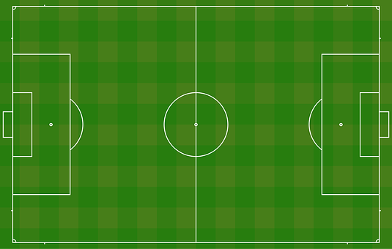
Process
Reserve field
Open FFR Application
Search field
Return list of fields
Choose field, time frame then pay
Reserve
3.Return list of fields
5. Reserve
FFR System
2. Search field
4. Choose field, time frame then pay
1. Open FFR Application
98

Slide 99
Process
Reserve field
Open FFR Application
Search field
Return list of fields
Choose field, time frame then pay
Reserve
Return result
Send notification
3.Return list of fields
5. Reserve
FFR System
2. Search field
4. Choose field, time frame then pay
7. Send notification
6. Return result
1. Open FFR Application
99

Slide 100
Process
Demo Reserve Field
100

Slide 101
Solutions
How to match opponent and create a match?
101

Slide 102
Solutions
How to match opponent and create a match?
Find suitable opponent
Find suitable field
102

Slide 103
Scenario 3
How to find suitable opponent?
Address: 297, Cộng Hòa, phường 4, quận Tân Bình
Free time: 14:00 – 17:00
Duration: 2 hour
Field Type: 5 vs 5
Rating points: 85
Search radius: 5 km
Mr.Thành
103

Slide 104
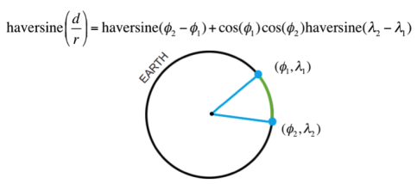
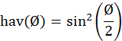
Algorithms
Calculate distance two points with Haversine
d is the distance between the two points
r is the radius of the sphere,
φ₁, φ₂: latitude of point 1 and latitude of point 2, in radians
λ₁, λ₂: longitude of point 1 and longitude of point 2, in radians
104

Slide 105
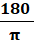
Algorithms
Calculate distance two points with Haversine
Note that φ and λ can be converted from radians to degrees by multiplying by
The latitude of Ho Chi Minh City, Vietnam is 10.762622, and the longitude is 106.660172.
Let latitude1 = latitude2 = 10.76, d = 5(km), r = 6.367.449(m)
longitude2 = longitude1 ± 0.0455 (in decimal)
Let longitude1 = longitude2, d=5 (km), r = 6.367.449(m)
latitude2 = latitude1 ± 0.0455 (in decimal)
105

Slide 106
Algorithms
Calculate distance two points with Haversine
A₁ (x - a, y + b)
A₂ (x + a, y + b)
x: latitude of A
y: longitude of A
a: deviation of latitude
B: deviation of longitude
5 km
A (x, y)
5 km
A₃ (x - a, y - b)
A₄ (x + a, y - b)
106

Slide 107
Algorithms
Calculate distance two points with Haversine
A₁ (x - a, y + b)
A₂ (x + a, y + b)
x: latitude of A
y: longitude of A
a: deviation of latitude
B: deviation of longitude
5 km
A (x, y)
5 km
A₃ (x - a, y - b)
A₄ (x + a, y - b)
107

Slide 108
Algorithms
Find suitable opponent
300, Trường Chinh, phường 5, quận Tân Bình
Free time: 14:00 – 19:00
Duration: 2 hour – Field type: 5 vs 5
Rating points: 150
Search radius: 5 km
175, Hồ Văn Huê, phường 3, quận Phú Nhuận
Free time: 13:00 – 17:00
Duration: 2 hour – Field Type: 5 vs 5
Rating points: 90
Search radius: 7 km
Mr.Huấn
Mr.Hiếu
500 Thoại Ngọc Hầu, Quận Tân Bình
Free time: 10:00 – 17:00
Duration: 3 hour - Field type: 5 vs 5
Rating points: 80
Search radius: 5 km
Mr.Quý
Mr.Thành
Step 1: Based on distance criteria: System founds matching requests of Mr. Huấn, Mr. Hiếu. Mr. Quý.
108

Slide 109
Algorithms
Find suitable opponent
After Step 1: Based on distance criteria.
Free time: 14:00 – 19:00
Duration: 2 hour
Field type: 5 vs 5
Rating points: 150
Blacklist: Mr.Quý
Free time: 10:00 – 17:00
Duration: 3 hour
Field type: 5 vs 5
Rating points: 80
Blacklist: No
Free time: 13:00 – 17:00
Duration: 2 hour
Field Type: 5 vs 5
Rating points: 90
Blacklist: No
Mr.Huấn
Mr.Quý
Mr.Hiếu
Mr.Thành
Free time: 14:00 – 17:00
Duration: 2 hour
Field Type: 5 vs 5
Rating points: 85
Blacklist: No
109

Slide 110
Algorithms
Find suitable opponent
After Step 1: Based on distance criteria.
Free time: 14:00 – 19:00
Duration: 2 hour
Field type: 5 vs 5
Rating points: 150
Blacklist: Mr.Quý
Free time: 10:00 – 17:00
Duration: 3 hour
Field type: 5 vs 5
Rating points: 80
Blacklist: No
Free time: 13:00 – 17:00
Duration: 2 hour
Field Type: 5 vs 5
Rating points: 90
Blacklist: No
Mr.Huấn
Mr.Quý
Mr.Hiếu
Step 2: Based on field type, time and blacklist criteria:
Have same field type
Duration of opponent must be less than or equal duration of Mr.Thành
Opponent is not in the blacklist of Mr.Thành
Mr.Thành
Free time: 14:00 – 17:00
Duration: 2 hour
Field Type: 5 vs 5
Rating points: 85
Blacklist: No
Free time: 14:00 – 19:00
Duration: 2 hour
Field type: 5 vs 5
Rating points: 150
Blacklist: Mr.Quý
Free time: 13:00 – 17:00
Duration: 2 hour
Field Type: 5 vs 5
Rating points: 90
Blacklist: No
Mr.Huấn
Mr.Hiếu
110

Slide 111
Algorithms
Find suitable opponent
After Step 1: Based on distance criteria.
After Step 2: Based on field type, time and blacklist criteria.
Free time: 14:00 – 19:00
Duration: 2 hour
Field type: 5 vs 5
Rating points: 150
Blacklist: Mr.Quý
Free time: 13:00 – 17:00
Duration: 2 hour
Field Type: 5 vs 5
Rating points: 90
Blacklist: No
Mr.Huấn
Mr.Hiếu
Step 3: Based on ranking point criteria:
Difference ranking point is not exceed 50 points
Mr.Thành
Free time: 14:00 – 17:00
Duration: 2 hour
Field Type: 5 vs 5
Rating points: 85
Blacklist: No
Free time: 13:00 – 17:00
Duration: 2 hour
Field Type: 5 vs 5
Rating points: 90
Blacklist: No
Mr.Hiếu
111

Slide 112
Algorithms
Find suitable opponent
After Step 1: Based on distance criteria.
After Step 2: Based on field type, time and blacklist criteria.
After Step 3: Based on ranking point criteria.
Free time: 14:00 – 17:00
Duration: 2 hour
Field Type: 5 vs 5
Rating points: 85
Blacklist: No
Favorites Field: Sân bóng đá Âu Cơ
Free time: 13:00 – 17:00
Duration: 2 hour
Field Type: 5 vs 5
Rating points: 90
Blacklist: No
Favorites Field: No
Mr.Thành
Mr.Hiếu
14h – 17h
Step 4: Free time of Mr.Hiếu is longer than Free time of Mr.Thành
=> Mr.Thành has permission to select times. 15h – 17h
112

Slide 113
Algorithms
Find suitable opponent
After Step 1: Based on distance criteria.
After Step 2: Based on field type, time and blacklist criteria.
After Step 3: Based on ranking point criteria.
After Step 4: Select times for match
Match Information
Start time: 15:00
End time: 17:00
Field Type: 5 vs 5
Mr.Thành
Mr.Hiếu
113

Slide 114
Solutions
2. How to find suitable field for two users?
114

Slide 115
Solutions
2. How to find suitable field for two users?
+ Search for field in the search radius requested by two users, the returned list contain common field of two lists.
+ If there are common favorites field of two user or one of two users in return list, system will only recommend these fields.
+ If there are no favorites field of any user in return list, system will return all returned list.
115

Slide 116
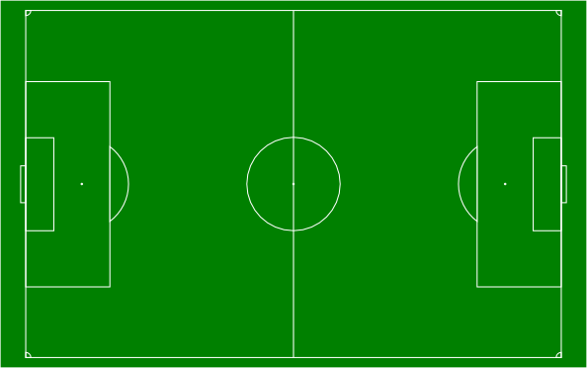
Algorithms
Find suitable field
Step 1: Based on search radius criteria: System founds 2 field in common search area of 2 user.
Sân bóng đá mini Chảo lửa
Sân bóng đá Lạc Long Quân
Mr.Thành
Search radius: 5 km
Mr.Hiếu
Search radius: 7 km
Sân bóng đá Âu Cơ
116

Slide 117
Algorithms
Find suitable field
After Step 1: Based on search radius.
Sân bóng đá mini Chảo lửa
Sân bóng đá Lạc Long Quân
VS
Mr.Thành
Search radius: 5 km
Mr.Hiếu
Search radius: 7 km
117

Slide 118
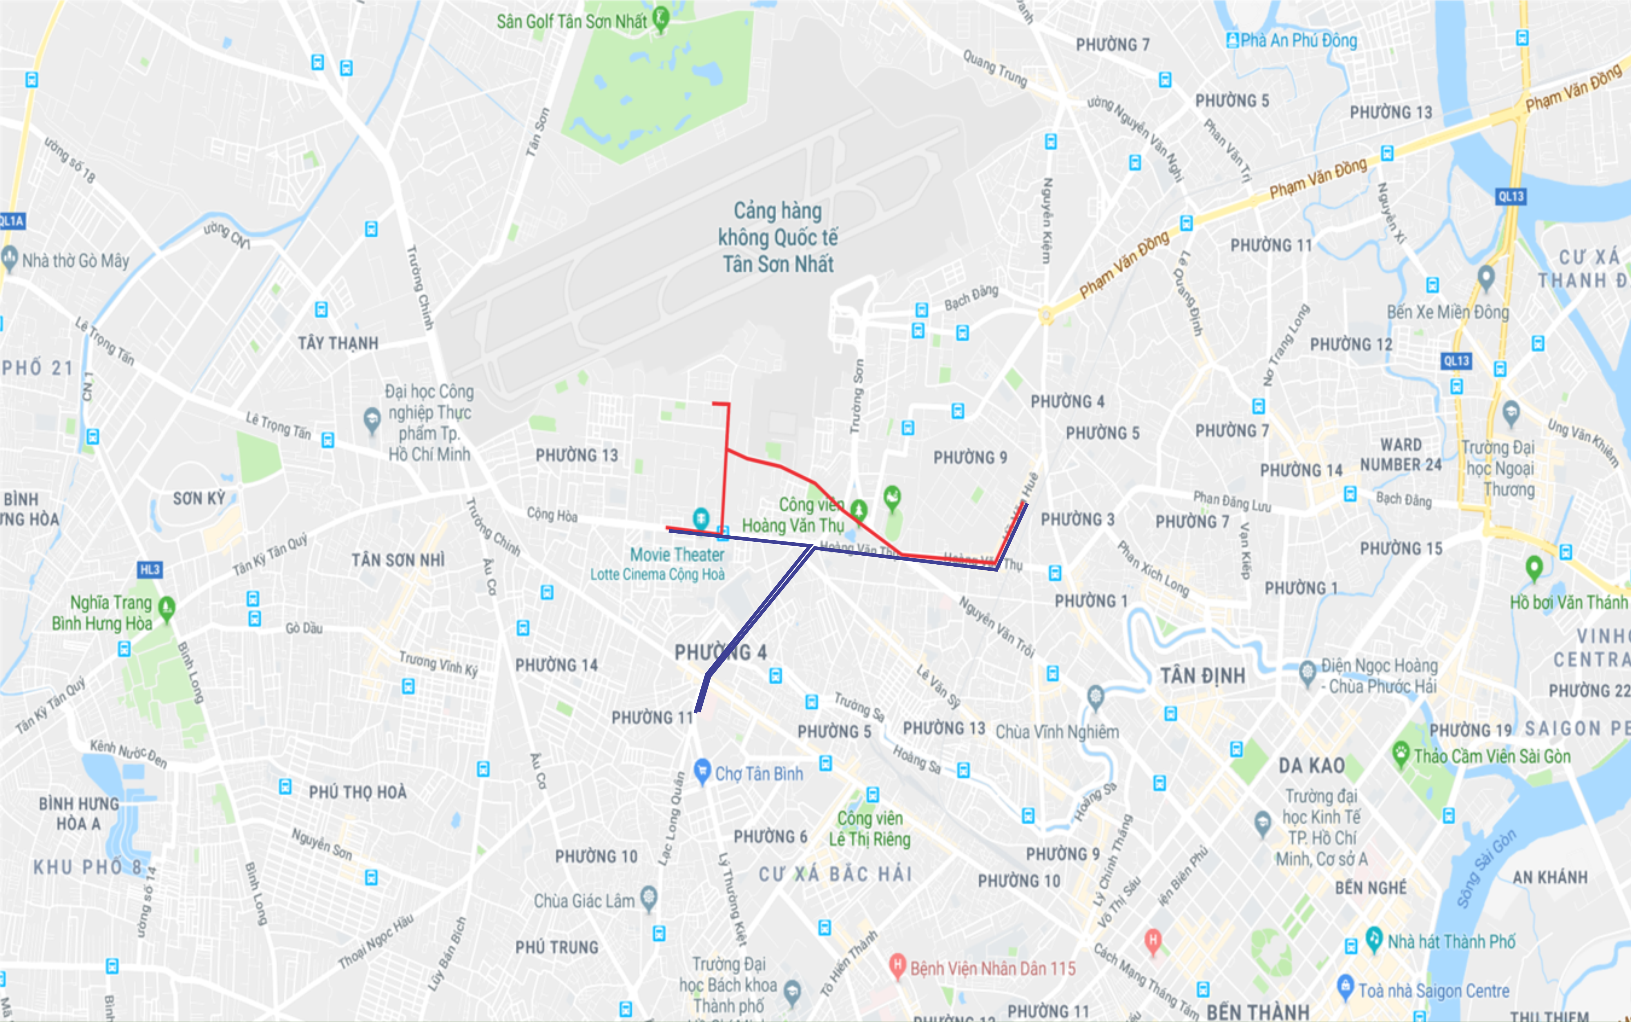
Scenario 4
Find suitable field
After Step 1: Based on search radius.
Sân bóng đá mini Chảo lửa
Step 2: Based on actual distance from Google Map API: System check actual distance from each user to field <= search radius of user.
0.8 km
Sân bóng đá Lạc Long Quân
1.7 km
1 km
1.6 km
Mr.Thành
Search radius: 5 km
Mr.Hiếu
Search radius: 7 km
118

Slide 119
Algorithms
Find suitable field
After Step 1: Based on search radius.
Sân bóng đá mini Chảo lửa
15h – 17h
180.000 VNĐ
After Step 2: System suggests Chảo Lửa field before Lạc Long Quân field.
0.8 km
Sân bóng đá Lạc Long Quân
15h – 17h
170.000 VNĐ
1.7 km
1 km
1.6 km
Step 3: System check free time of field: Lạc Long Quân Field and Chảo Lửa Field have free time.
Mr.Thành
Search radius: 5 km
Mr.Hiếu
Search radius: 7 km
119

Slide 120
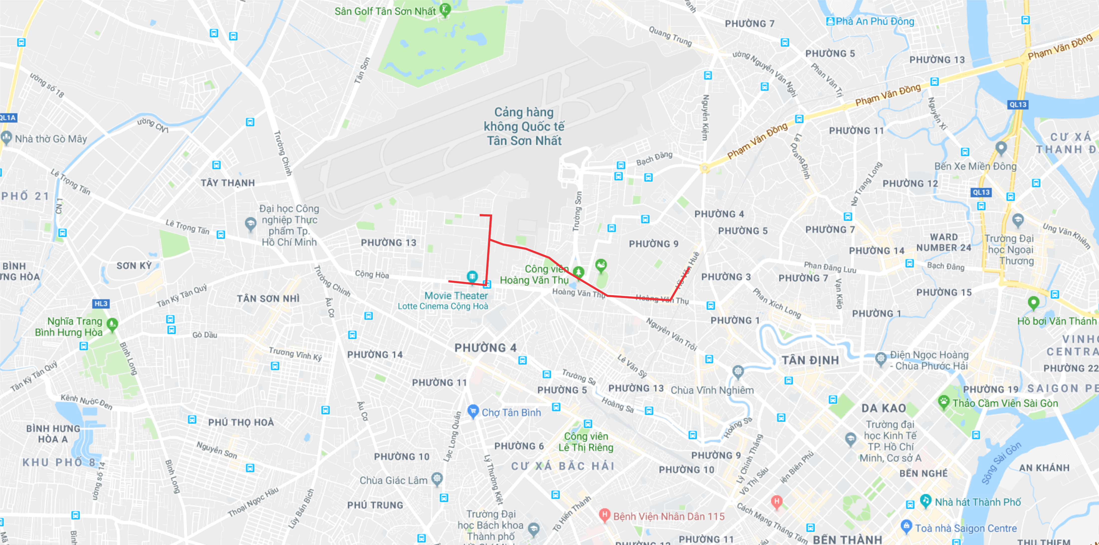
Algorithms
Find suitable field
After Step 1: Based on search radius.
After Step 2: Based on actual distance.
After Step 3: System check free time.
VS
Mr.Thành
Mr.Hiếu
Sân bóng đá mini Chảo lửa
15h – 17h
180.000 VNĐ
1.7 km
0.8 km
Mr.Thành
90.000 VNĐ
Mr.Hiếu
90.000 VNĐ
120

Slide 121
Process
Match opponent
1. Open FFR application
2. Search then choose opponent
Mr. Thành
Mr. Quý
4. Set time frame
then reserve
3. Choose field
Ms. Linh
121
Notes:
Story: Mr.Thành muốn tìm kiếm đối thủ cho đội bóng của mình.
Đầu tiên: Thành sử dụng điện thoại có cài đặt app FFR.
Tiếp theo: Khi yêu cầu hệ thống tìm đối thủ, Quý có trong danh sách phù hợp với yêu cầu của Thành do hệ thống gợi ý. Thành chọn Quý làm đối thủ của mình.
Kế đến, THành lựa chọn sân của chủ sân Linh – là một trong những sân phù hợp với yêu cầu của cả 2
B3: Cuối cùng, Sau khi chọn sân, Thành cài đặt thời gian theo khung giờ rảnh của sân, trả tiền rồi đặt sân.

Slide 122
Process
Match opponent
Open FFR Application
Send matching request
FFR System
2. Send matching request
1. Open FFR Application
122

Slide 123
Process
Match opponent
Open FFR Application
Send matching request
Return opponent list
3.Return opponent list
FFR System
2. Send matching request
1. Open FFR Application
123

Slide 124
Process
Match opponent
Open FFR Application
Send matching request
Return opponent list
Choose opponent
3.Return opponent list
FFR System
2. Send matching request
4.Choose opponent
1. Open FFR Application
124

Slide 125
Process
Match opponent
Open FFR Application
Send matching request
Return opponent list
Choose opponent
Return field list
3.Return opponent list
FFR System
2. Send matching request
4.Choose opponent
5. Return field list
1. Open FFR Application
125

Slide 126
Process
Match opponent
Open FFR Application
Send matching request
Return opponent list
Choose opponent
Return field list
Choose field then pay
6. Choose field then pay
FFR System
126

Slide 127
Process
Match opponent
Open FFR Application
Send matching request
Return opponent list
Choose opponent
Return field list
Choose field then pay
Reserve
7. Reserve
6. Choose field then pay
FFR System
127

Slide 128
Process
Match opponent
Open FFR Application
Send information
Return opponent list
Choose opponent
Return field list
Choose field then pay
Reserve
Send notification to field owner
Send notification to opponent
Return result
7. Reserve
6. Choose field then pay
FFR System
9. Send notification to opponent
8. Send notification to field owner
10. Return result
128

Slide 129
Process
Demo Match Opponent
129

Slide 130
Algorithms
Calculating rating bonus point
User who creates an account will have default rating points = 100.
Calculating rating score based on rating of user after match.
Check rating result from two users for verification.
1. Match has winner:
+ Winner’s rating points = winner’s current rating points + 30 points + difference goals.
+ Loser’s rating points = loser’s current rating points – difference goals.
2. Draw match:
User’s rating points = current rating points + 10 points.
Ex: Mr. Thành has rating points = 120 vs Mr. Huấn has rating points = 80.
Mr. Thành is the loser after match with difference goals = 4 goals.
Mr.Thành’s rating points = 120 – 4 = 116.
Mr. Huấn’s rating points = 80 + 30 + 4 = 114.
130

Slide 131


Values
For field owner:
System supports field owner in managing the field.
Field owner can attract users in idle times by setting discount price, free services for each time frame.
131

Slide 132
Values
For User:
Reservation transaction is proceeded online smoothly.
Users can find opponents with the matching system.
132

Slide 133

Challenge
The application depends on user’s behaviors.
The notification mechanism of application uses Firebase, the distance calculation uses Google API, depends on bandwidth.
Security problem is not really good.
133

Slide 134
Part 4
Future Plan

Slide 135
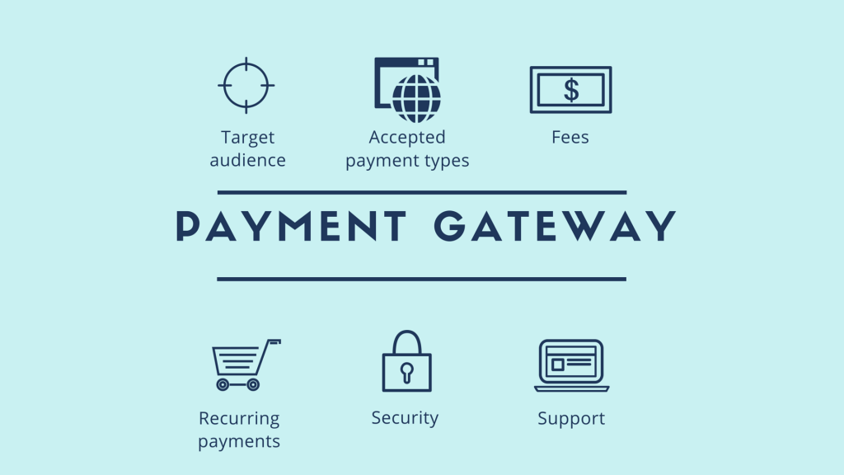
Future Plan
Build Mobile Application for Field Owner.
Allow user to pay by multiple payment gateways.
Extend interaction with many Field Owner outside Ho Chi Minh City
135

Slide 136
Thanks you for listening!
Q & A

